Slide 1
FLS Unit 4
DS6371
Johnny Vogt
Type Errors and Powers

Slide 2
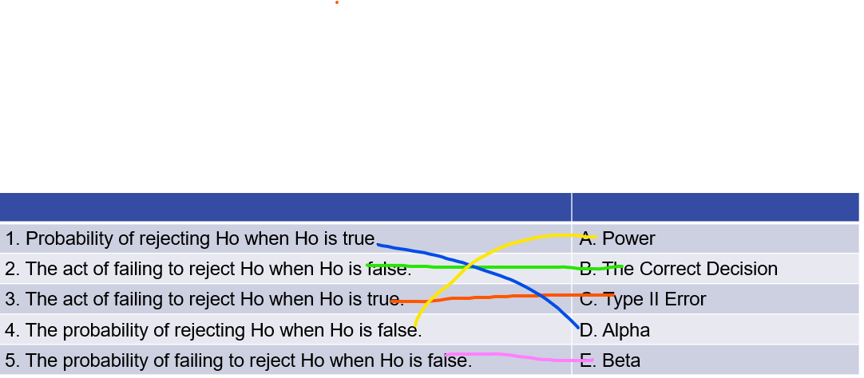
Quick Questions :D

Slide 3
Question 2
A
C
F
H

Slide 4
Question 3
The power is stronger with the t-test on the log-transformed data because there is the log transformation actually normalizes the data. After the transformation, both samples are less affected by their skew and outliers. Raw Income data is generally very skewed by using it without any transformation. Applying a logarithmic function on the income data, you would reduce the amound of variance and help create eh conditions for the strongest T-Test.

Slide 5
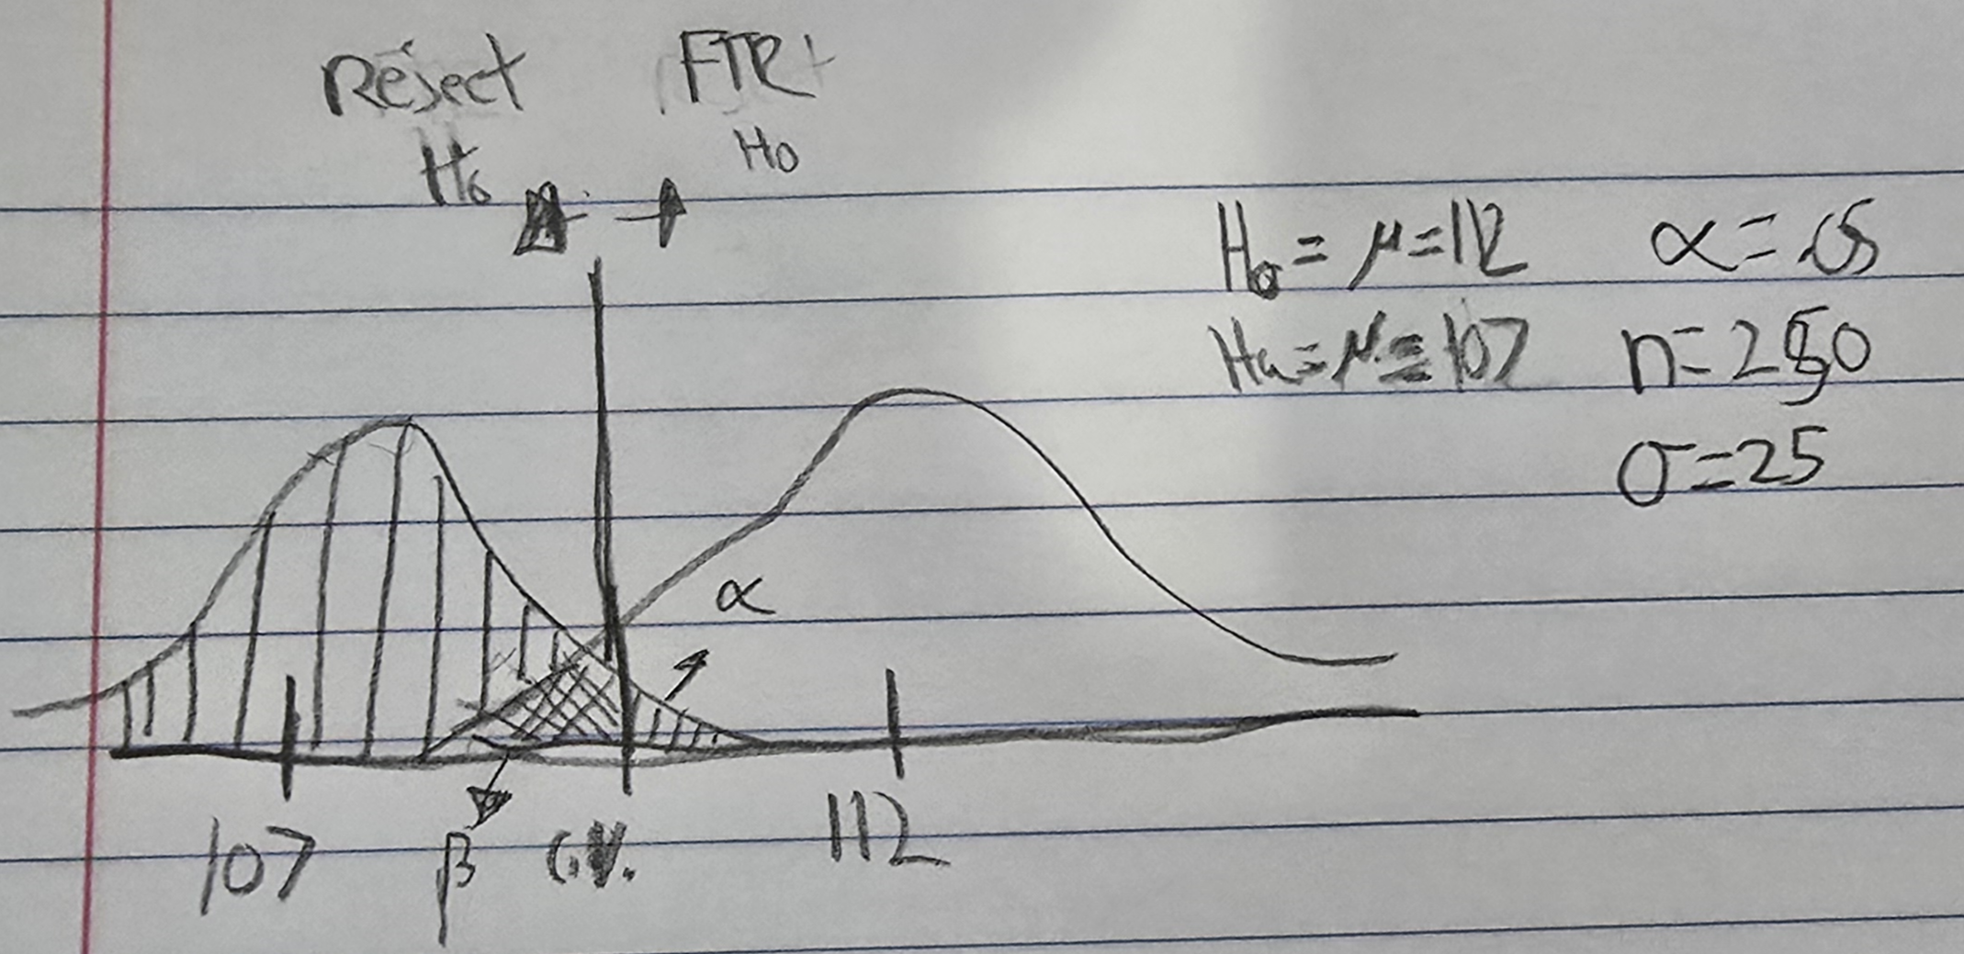
Real Question 2
Fail to Reject H0, when H0 is true: Type I Error
With a significance level of 5%, the chances would be 5% since it would be one-sided.
|5|
95%
Power

Slide 6
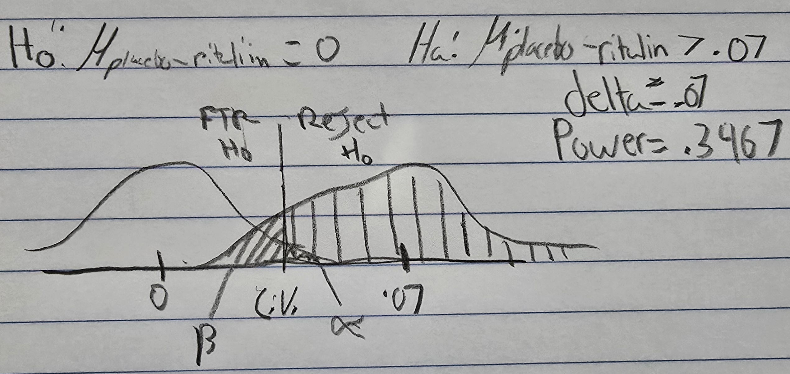
Question 3 Ritalin Recollection
The probability of Ritalin not actually slowing down reaction times with our sample set, the probability would be .06. The evidence definitely leaned towards rejecting it.
The power of the Test drops to .35

Slide 7
Question 3 Power CURRRVE
See below for the power curve, and its seems the researchers would jneed a sample size just below 150 to achieve a power of 80%

Slide 8
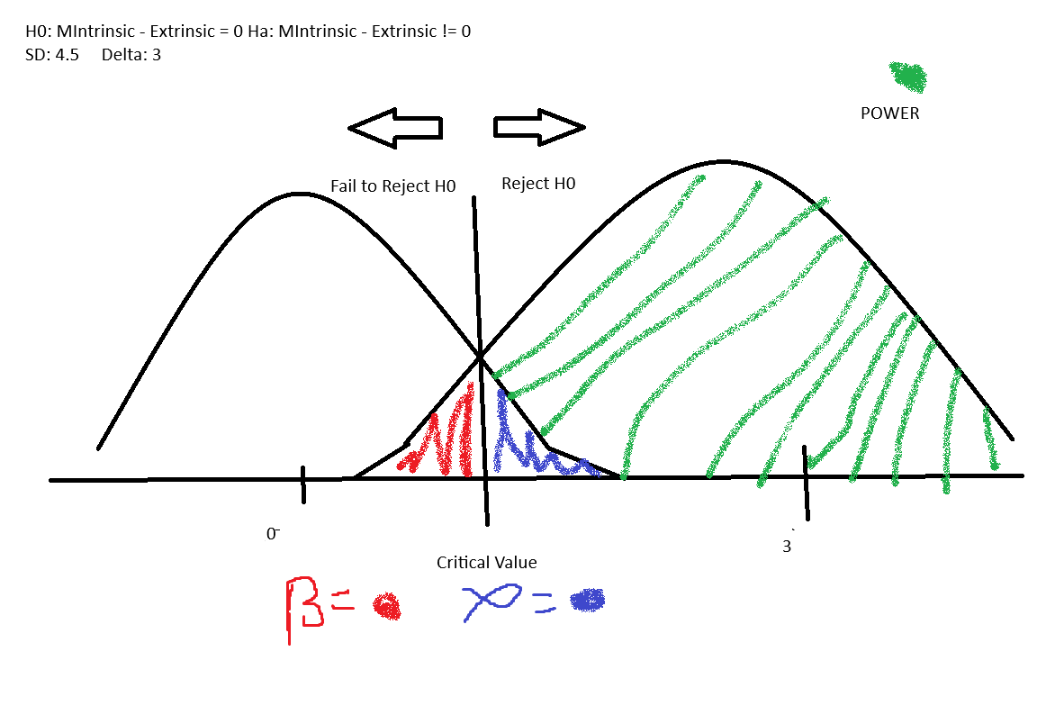
Question 4 Creativity Story
The power was .86 and .85 (I came up with two, since there's two sample sizes)
The Power grows significantly when you increase the Effect Size.
I will never use MS Paint again
I thought It’d be easier.

Slide 9
Question 4:4 Power Chord..I mean Curve

Slide 10
Takeaways
Barely had any examples of two samples with different sample sizes, or atleast maybe I skimmed too fast
Is delta only just the difference between means? (effect size?)
Things are starting to get a little more confusing, I’ll probably have to keep drawing that square thing and distributions to make things make sense
There was a question about increasing the effect size, and when I did it, it increased the power, but I would’ve figured the power would’ve gone down, since the effect size should’ve eaten into the power?

